Slide 1
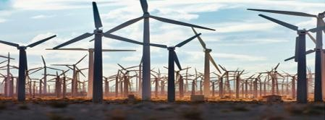
L-T-P-C
3-0-0-3
RENEWABLE ENERGY ENGINEERING
Module - III

Slide 2
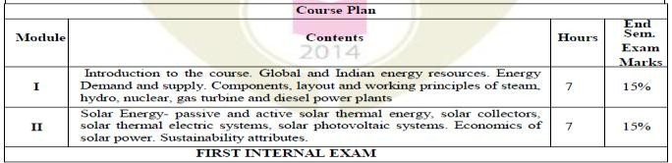
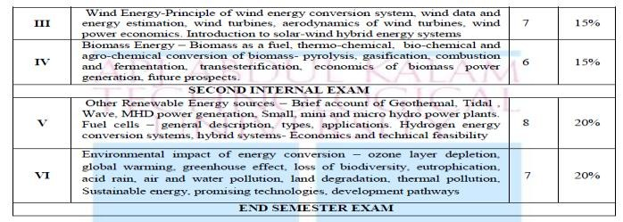
4

Slide 3
After successful completion of this course, students will be able to
Course Outcomes
Sl. NO | DESCRIPTION | PO MAPPING
1 | Discuss and compare the layout and working principles of steam, hydro, nuclear, gas turbine and diesel power plants. | PO1
2 | Describe the use of solar energy and the various components used in the energy production. | PO1
3 | Appreciate the need of wind energy and the various components used in energy generation and know the classifications. | PO1
4 | Acquire knowledge about the concept of power generation from biomass energy resources and their future prospects and economics. | PO1
5 | Describe the principles and applications of power generation from various sources and Hydrogen energy conversion systems. | PO1
6 | Understand energy scenario and the environmental effects of energy conversion and become aware of different renewable energy sources and choose sustainable energy for future. | PO1
3

Slide 4
Energy from the wind
Wind = air in motion;
-caused by the uneven heating of the earth‘s surface by the sun;
The large atmospheric winds that circle the earth are created because the land near the earth's equator is heated more by the sun than the land near the North and South Poles.
Today, wind energy is mainly used to generate electricity.
Wind is called a renewable energy source because the wind will blow as long as the sun shines.

Slide 5
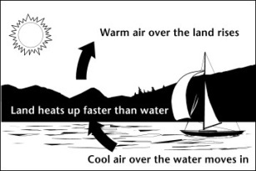
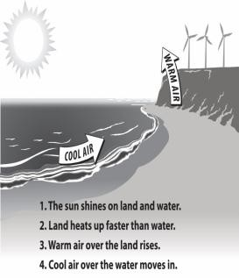
What Makes Wind?
Heat from sun causes convection in the atmosphere, i.e., the heated air rises, which create zones of high and low air pressure within the atmosphere.
As the heated air rises, it creates a low pressure zone near the ground. Air from surrounding cooler areas rushes in to balance the pressure.
These horizontal pressure difference accounts for ambient wind and the more intense storm wind

Slide 6
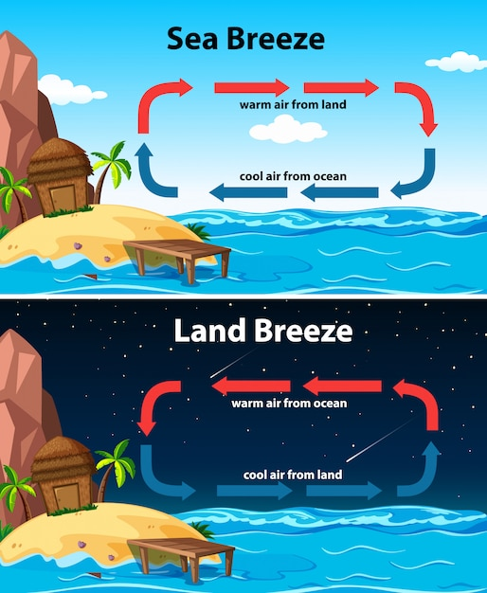

Slide 7
Wind Power Plant
Wind flow is created as an effect of solar heat, which creates low and high-pressure regions on the earth due to heating.
Thus wind energy is rightly an indirect form of solar energy. The flowing wind is used to rotate the wind turbine, which is also known as windmill.
Wind turbines are usually located at the sea shore or in the sea where there is availability of wind.
For electric power generation, the average wind speed required is 5 m/s.
10

Slide 8
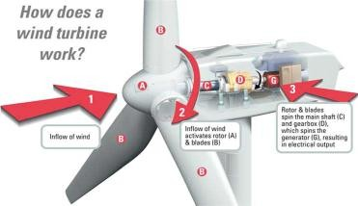
What is Wind Energy?
Differential heating of the Earth’s surface and atmosphere causes vertical/horizontal air currents known as WIND.
A wind turbine then produces electricity by converting the force of the wind ultimately charging a generator through the rotation of the wind turbine’s rotor blades.
Wind pushes blades
Blades attached to a hub
‒ together called the rotor
Rotor spins drive shaft
Gearbox makes shaft faster
Drive shaft turns generator to make energy
9

Slide 9
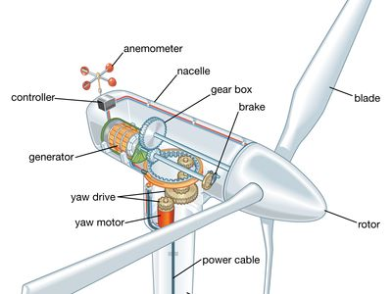
Parts of wind turbine

Slide 10
yaw pitch and roll

Slide 11
Why Wind Energy?
Wind is the renewable energy resource/technology of choice
“Free” resource
A “clean” resource due to:
Replacement of a “dirty” energy source (coal) and,
No emissions associated with its use
Can be utilized on underutilized land or on lands currently in commodity crop production (“harvest” on the surface and “harvest” above the surface)
2

Slide 12
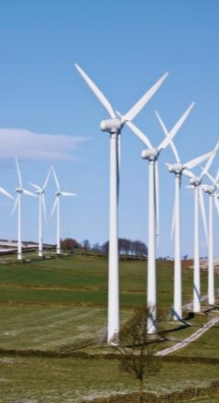
Why Wind Energy?
Clean, zero emissions
NOx, SO2, CO, CO2
Air quality, water quality
Climate change
Reduce fossil fuel dependence
Energy independence
Domestic energy— national security
Renewable
No fuel-price volatility

Slide 13
History of Wind Energy
5000 BC - The history of wind energy is certainly long, beginning thousands of years ago. It is estimated that as early as 5000 B.C. sail boats were in use on the Nile as boatmen realized the power of the wind.
500-900 AD - The first windmills were developed in Persia for pumping water and grinding grain.
About 1300 - The first horizontal-axis windmills appeared in Western Europe.
1850s - Daniel Halladay and John Burnham worked to build and sell the Halladay Windmill, which was designed for the American West. It had an open tower design and thin wooden blades. They also started the U.S. Wind Engine Company.
Late 1880s - Thomas O. Perry conducted over 5,000 wind experiments trying to build a better windmill. He invented the mathematical windmill, which used gears to reduce the rotational speed of the blades. This design had greater lifting power, smoother pumping action, and could operate in lighter winds. Perry started the Aermotor Company with LaVerne Noyes.
The development of steel blades made windmills more efficient. 6 million windmills sprang up across America as settlers moved west. Homesteaders purchased windmills from traveling salesman, or they built their own. Mills were used to pump water, shell corn, saw wood, and mill grain.

Slide 14
History of Wind Energy
5000 BC 500-900 AD 1300 AD
1850s
Daniel Halladay and John Burnham build Halladay Windmill; start US Wind Engine Company
Late 1880s Thomas O. Perry conducted 5,000 wind experiments; starts Aermotor Company
Sailboats used on First windmills First horizontal- the Nile indicate developed in axis
the power of wind Persia
windmills in
Europe
1888
Charles F. Brush used windmill to generate electricity in Cleveland, OH
Early 1900s Windmills in CA pumped saltwater to evaporate ponds
1941
In VT, Grandpa’s Knob turbine supplies power to town during WWII
1979
First wind turbine rated over 1 MW began operating
1985
CA wind capacity
1993
US WindPower developed
2004
Electricity from
2013
Wind power provided over 17% of renewable energy used in US
exceeded 1,000 MW first commercial variable-speed wind generation
wind turbine
costs 3 to 4.5 cents per kWh

Slide 15
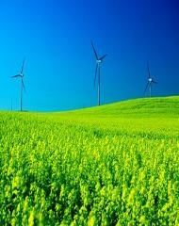
Why Such Growth? …costs are low!
Increased Turbine Size
R&D Advances
Manufacturing Improvements
The rapid growth in wind power can be attributed to two things.
reduction in cost of electricity produced
more interest in renewable technologies.
Between 2004 to 2011, an increase in price can be attributed to higher rates of demand than supply of turbines and rising commodity prices including a rise in the price of steel.
1979
40 cents/kWh
2000
4-6 cents/kWh
2004
3-4.5 cents/kWh
2011
< 5 cents/kWh

Slide 16
Is Wind Energy Truly Sustainable?
Yes
– All you need is wind!
There is no use for any fossil fuels to power a wind turbine.
Lifespan of New Wind Farms
Industry predictions: 20-25 years
Actual findings: No more than 12-15 years
The machinery needs to be replaced; there is wear and tear of the turbines over time.
19

Slide 17
Advantages of Wind Energy
Wind blows day and night, which gives wind turbines the ability to produce electricity at all hours of the day.
Wind energy is a domestic source of energy, produced in the United States and the nation’s wind supply is abundant.
Clean
Wind energy is a renewable source of energy that generates no pollution.
Unlike: fossil fuels such coal/natural gas
Does not produce atmospheric emissions that cause acid rain or greenhouse gasses.
Cheaper
Wind energy is one of the lowest-prices renewable energy technologies available today, costing between 4 and 6 cents per KWH
As of 2013, farmers who host wind turbines are typically paid at least $10,000 per turbine per year by companies that run wind farms.
Farmers can also still continue to use the land due to the turbines only taking up a fraction of the land.
22

Slide 18
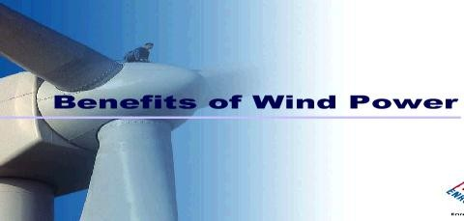
Environmental benefits
No air emissions No fuel needed
No fuel to mine, transport, or store
No cooling water No water pollution No wastes
21
Distributed power Remote locations

Slide 19
Merits and demerits of wind turbines
Advantages of wind power
Wind turbines can be used for both distributed generation or grid interactive power generation using on-shore or off shore technologies.
Ranges of power producing turbines are available. Micro-turbines are capable of producing 300 W to 1MW and large wind turbines have typical size of 35 kW–3 MW.
It can be made available easily in many off-shore, on-shore and remote areas; thus, helpful in supplying electric power to remote and rural areas.
It is a non-polluting and environment friendly source of energy.
It is an important renewable and sustainable source of energy, available free of cost.
The scope of wind resource, globally, is enormous and is less dependent on latitude than other solar based renewable energy technologies.
Power generation is cheaper as there is no shortage of input cost and recurring expenses are almost nil.
Disadvantages of wind power
It has low energy density.
Electricity production depends on- wind speed, location, season and air temperature. Hence various monitoring systems are needed and may cost expensive.
High percentage of the hardware cost (for large wind turbine) is spent on the tower designed to support the turbine
It is variable, unsteady, irregular, intermittent, erratic and sometimes dangerous.
Wind turbine design, manufacture and installation have proved to be complex due to widely varying atmospheric conditions in which they have to operate.
Wind farms can be located only in vast open areas in locations of favourable wind. Generally, such locations are away from load centres.
The appearance of wind turbines on the landscape and their continual whirling and
whistling can be irritating.
24

Slide 20
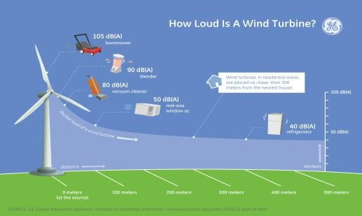
Impacts of Wind Power: Noise
In the past, turbines have been perceived as noisy machines. While modern day turbines do produce some noise, when sited at a proper distance from homes and businesses, the noise level is less than many household appliances.

Slide 21
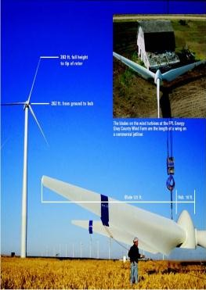
Installation of Wind Turbines
Large scale turbines are brought to the construction site in multiple pieces and assembled on site.
Specialized trucks transport the components to these often remote locations because, even though the turbine is disassembled, individual pieces are still very large.
Towers are transported in 65 to 100-foot long sections. Blades are transported one or two blades per truck.
Prior to erecting the tower, concrete foundations are poured to hold the turbine securely in place.
Large cranes are used to assemble the pieces, stacking the tower and nacelle first. The blades are attached to the hub on the ground and lifted on to the front of the nacelle.
Note the size comparison to the barn in the upper right hand corner.

Slide 22
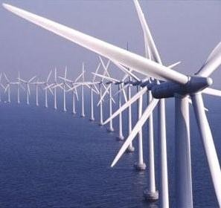
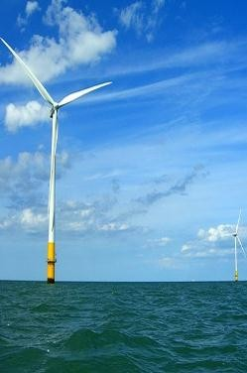
Offshore Wind Farms
Many developers would like to move wind farms offshore because wind is faster,
smoother and can be close to major population centers on the coast.

Slide 23
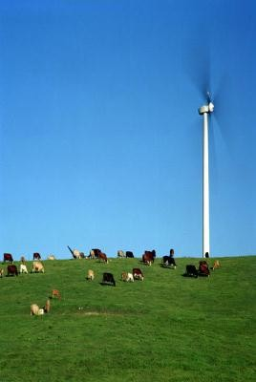
Common Misunderstandings
Wind turbines are only generating electricity about one third of the time.
Wind turbines generate electricity essentially all the time, but only at their rated capacity about 30-40% of the time.

Slide 24
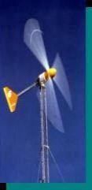
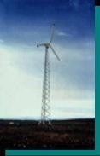
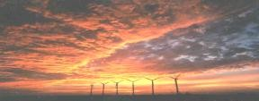
Turbines: Different sizes & Applications
Small (≤10 kW)
Homes (Grid-connected)
Farms
Remote Applications
(e.g. battery charging, water pumping, telecom sites)
Intermediate (10-500 kW)
Village Power
Hybrid Systems
Distributed Power
Large (500 kW – 5 MW)
Require 13-mph average wind sites
Central Station Wind Farms
Distributed Power
Offshore Wind
31

Slide 25
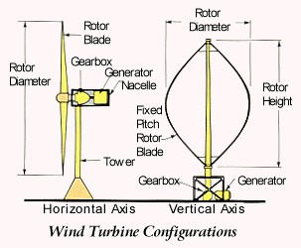
34

Slide 26
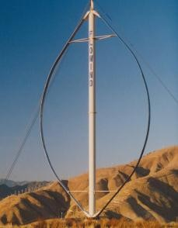
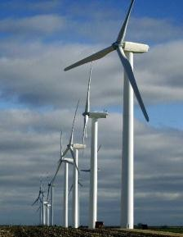
Modern Wind Turbines
Turbines can be categorized into two classes based on the orientation of the rotor.
33

Slide 27
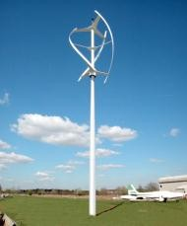
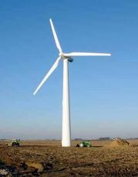
Different Types of Wind Turbines
Wind Turbines
If the mechanical energy is then converted to electricity, the machine is called a wind generator.
36

Slide 28
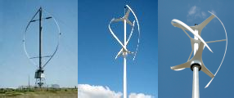
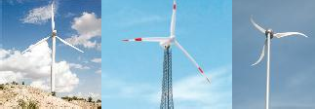
General Types of Wind Turbines
Vertical Axis Wind Turbine – Uncommon
Horizontal Axis Wind Turbine – More Common
37

Slide 29
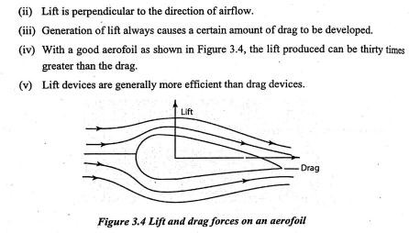
Wind Energy Conversion
Principle of wind energy conversion
(i) Drag is in the direction of air flow
40

Slide 30
Wind Turbine Power
P = 0.5 × rho × A × Cp × V³ × Ng × Nb
P = power in watts (746 watts = 1 hp)
rho = air density (about 1.225 kg/m³ at sea level, less higher up) A = rotor swept area, exposed to the wind (m²)
Cp = Coefficient of performance
(0.59 {Betz limit} is the maximum theoretically possible, 0.35 for a good design)
V = wind speed in meters/sec (20 mph = 9 m/s)
Ng = generator efficiency
(50% for car alternator, 80% or possibly more for a permanent
magnet generator or grid-connected induction generator)
Nb = gearbox/bearings efficiency (could be as high as 95% if good)
39

Slide 31
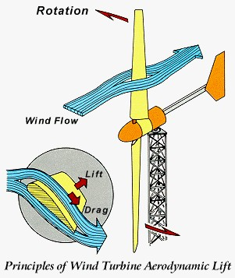
42

Slide 32
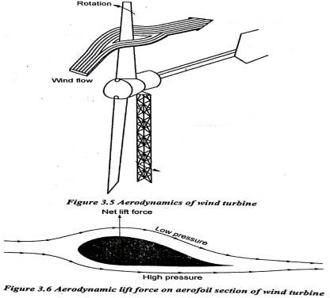
Aerodynamics of wind turbines
43

Slide 33
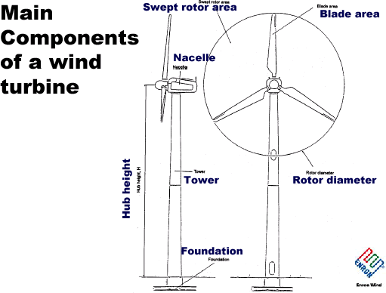
46

Slide 34
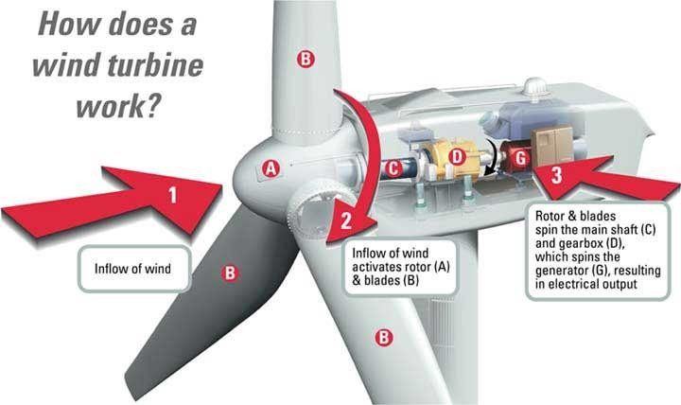
How a Wind Turbine Operates

Slide 35
Components of wind turbine
Hub – The blades are attached to the hub.
Rotor – Blades and hub together is called the rotor. Rotor is attached to the slow speed shaft.
Nacelle – Nacelle is the cover housing that houses all of the generating components in a wind turbine, including the generator, gearbox, drive train, and brake assembly.
Tower– The tower of the wind turbine
Blade
Nacelle
Gear box
Hub
Generator
Tower
carries the nacelle and the rotor. Towers Horizontal axis wind power plant
may be made from steel or concrete. (Propeller type)
5. Gears– Gears connect the low-speed shaft attached to the hub to the high- speed shaft attached to the generator and increase the rotational speed.
48

Slide 36



Upwind and downwind machines
Wind direction sensor
Tail vane
Shadow area
Upwind with tail vane (passive yaw control)
Upwind with active yaw control
Downwind with free yaw (active yaw for large turbines)
Yaw control in upwind and downwind machines
Upwind machines are those machines that have rotor facing the wind. In these machines the wind meets the rotor first and then leaves from the direction in which the nacelle is located.
In a downwind machine, the rotor is located downwind of (behind) the tower as shown in the figure. This means the nacelle comes first in the path of the wind and then the blades.
49

Slide 37

Vertical axis wind turbines
(VAWT)
The basic vertical axis designs are the Darrieus type, which has curved blades and efficiency of 35%, and the Savonius type having the efficiency of 30%.
Savonius type
Savonius type uses drag forces to create rotation of the shaft. Savonius windmill consists of a hollow circular cylinder sliced in half, the two halves being fixed to a vertical axis with a gap in between
Darrieus type
Darrieus type uses lift forces to create the rotation of the shaft. Darrieus type requires much less surface area. It is shaped like an egg beater and has two or three blades
shaped like aerofoils.
52

Slide 38

Horizontal axis wind turbines (HAWT)
Commonly found horizontal axis wind turbines are multi-blade type, sail type and propeller type. Both the multi-blade and sail- type wind turbines run at low speeds of 60 to 80 rpm. The propeller type has two or three aerofoil blades and run at speeds of 300 to 400 rpm.
Multi blade type
Sail type
51

Slide 39
Comparing HWT and VWT
Parameter | HWT | VWT
Tip speed ratio | High and hence noisy. | Low and hence less noisy.
Application | Large scale electricity generation. | Small scale electricity generation.
Yawing | Yawing is required, as HWTs are dependent of wind direction. | Yawing is not required, as HWTs are independent of wind direction, but are affected by wind speed.
Torque | Low. | More at lower wind speeds.
Maintenance | Difficult. | Easier, as heavy components can be located at the ground level.
Stability | More stable and hence large sized turbines can be constructed. | Less stable.
54

Slide 40
Performance of wind turbines
The tip-speed ratio is the ratio of the rotational speed of the blade to the wind speed. The larger this ratio, the faster the rotation of the wind turbine rotor at a given wind speed. Lift-type wind turbines have maximum tip- speed ratios of around 10, while drag-type ratios are approximately 1.
0.6
Propeller (2 blade)
C 0.5
p
0.4
0.3
0.2
0.1
Ideal rotor
Multi-blade
Darrieus (3 blade)
Savonius
0 1 2 3 4 5 6 7
Tip speed ratio
The coefficient of performance is defined as the ratio of the power delivered by the rotor, P, to the maximum power available, P_{t}, in the
P
P
ρAV ³
wind and is given by the following expression.
C_{p} = _{P} = ₁
t
2
It is seen that the values of tip speed for the multi-blade and Savonius types are much lower than the values for the propeller and the Darrieus types. It is also seen that the highest values of C_{p} are obtained with the
propeller type.
55

Slide 41
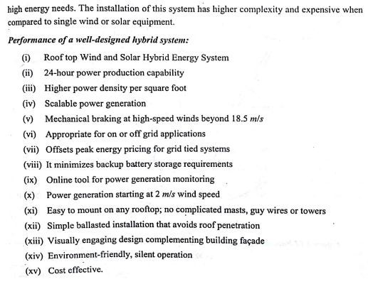
58

Slide 42
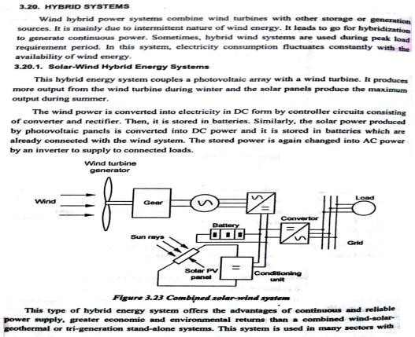
57

Slide 44
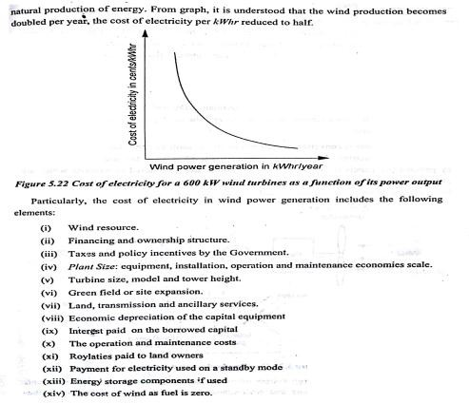
60

Slide 45

61

